Slide 1
Environmental Services Commission
City of Tacoma | Environmental Services Department
Thursday, October 14, 2021

Slide 2
Agenda
Welcome
Strategic Plan BEE Team Update: Christina Curran
Watershed Prioritization and Stormwater Outreach:
Shauna Hansen & Sarah Norberg
Other Items of Interest
Adjournment

Slide 3
2021 Work Plan
Meeting Date | Draft Topics
February 11 | Election of chair & vice-chair Meeting schedule for 2021 & work plan Five Utilities in Tacoma video
March 11 | Canceled
April 8 | Impacts of COVID-19 on Budget TMC 12.08 Updates Stormwater Management Manual Update
May 13 | Canceled Note: ES attends GPFC (Gov. Performance & Finance) meeting to provide an overview of ESC
June 10 | 2020 ES Financial Update Virtual Tours and Videos
July 15: Special Meeting Date | Tours: Solid Waste (tentative)
August 12 | Canceled
September 16: Special Meeting Date | Canceled
October 14 | ES Strategic Plan Update – Bee Team Update Watershed Prioritization and Stormwater Outreach
November 18: Special Meeting Date | Agenda for upcoming Rate & Budget Year Wastewater Comprehensive Plan Overview
December 9 | Canceled

Slide 4
Presentation
Strategic Plan: BEE Team Update
Presenter: Christina Curran, Budget, Rates, & Strategic Planning
Email: christina.curran@cityoftacoma.org
Phone: 253-591-5861

Slide 5

What is the BEE Team?
ES Budget Employee Engagement Team
Continuation of Strategic Plan
  Budget Transparency and Education Initiative
Goals is for greater employee involvement in budget development
  More than top-down approach
2020 had a BEE Team Pilot; 2021 Team will be working for input into the 2023-2024 Budget

Slide 6


BEE Team Roles and Responsibilities
1. Engage with fellow employees to generate ideas for changes that should be implemented in the upcoming
biennium to improve operations and work
2. Report back to the BEE Team to review and evaluate ideas

Slide 7

Evaluating BEE Team Ideas
What makes a quality budget proposal?
  Identifies problem and uses data to demonstrate predicted impact
  Aligns with goals, strategies, and initiatives
    Tacoma 2025
    Environmental Action Plan
    Department 10-Year Goals
    City Manger and Council priorities
  Consciously advances equity
  Includes collaboration with internal and external partners
Be Creative, ideas don’t have to be “budgety”

Slide 8

2021 BEE Team Efforts
2021 Team
11 employees across all 5 divisions
8 meetings (May to present)
35 ideas generated
  10 ideas prioritized for consideration in
  2023-2023 budget
    Support for training/internship/temporary work programs
    Cameras to help customers better plan access to services
    Urban Forestry support

Slide 9

BEE Team Next Steps
Completed
  Idea brainstorm and
  idea narrowing/prioritization
Next
  Share ideas with Division Managers for feedback
  Finalize proposal list
  Present proposals to management team
  Management response
    Ideas considered for includes in 2023-2024 ES Budget Proposals to City Manager

Slide 10
Presentation
Watershed Prioritization and Stormwater Outreach
Presenters:
Shauna Hansen, Stormwater Engineer
Email: shansen2@cityoftacoma.org
Phone: 206.229.2493
Sarah Norberg, Environmental Specialist
Email: snorberg@cityoftacoma.org
Phone: 253.208.0536

Slide 11
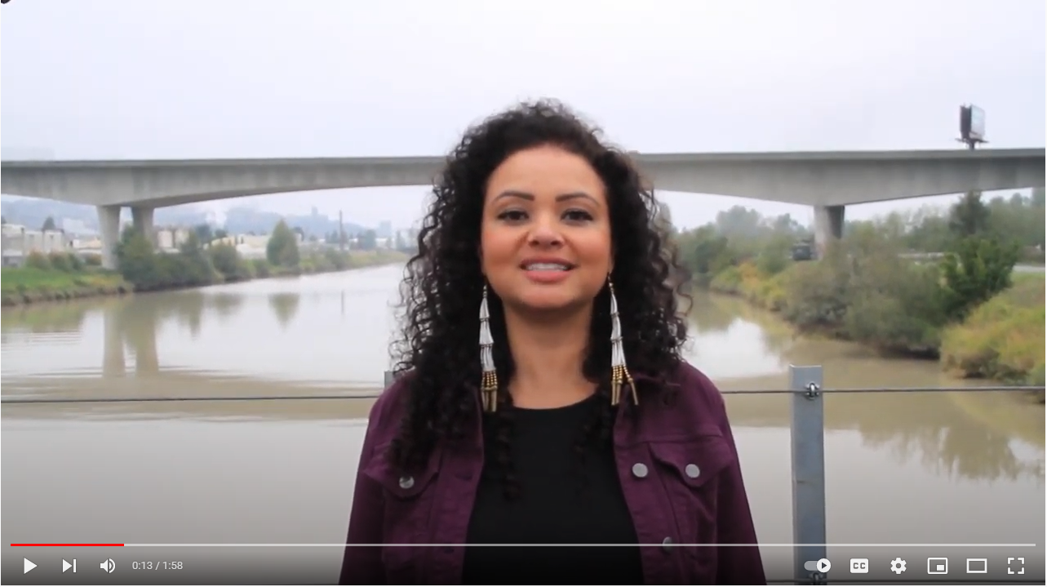

Puyallup Tribal Land Acknowledgment
Amber Sterud Hayward, Program Director, Puyallup Tribal Language Program
Notes:
We want to take a moment to gratefully acknowledge that we rest on the traditional lands of the Puyallup People where they make their home and speak the Lushootseed language. The Puyallup Tribe of Indians has stewarded and relied upon the lands and waters in Tacoma since time immemorial, and we benefit from their continued leadership today in co-managing the fisheries in the region with the WA Dept of Fish and Wildlife, and by leading and participating in habitat restoration efforts, harvest management/policy development, fish enhancement projects and research and monitoring activities. We want to start our watershed community workshop today by hearing from members of the Puyallup Tribe sharing a land acknowledgment in their own words.
Navigate to YouTube Vid in browser

Slide 12
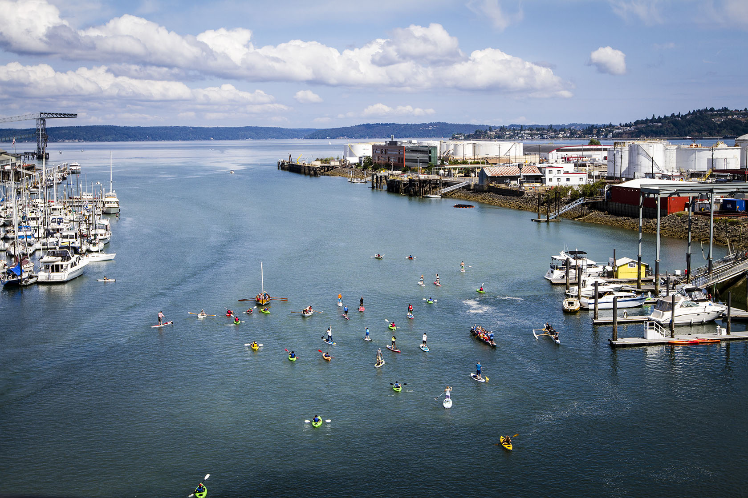
Watershed Planning Goals
Primary goal: Implementing strategic stormwater management to protect people, property, and habitats from stormwater flooding and pollution.
Equity and Environmental Justice
Clean Water and Healthy Ecosystems
Healthy Neighborhoods
Resilient Community
Smart Government Spending

Slide 13


Watershed Planning Flowpath
We are here!
PHASE 1
April 2020 – October 2021
PHASE 2
May 2020 – November 2022
PHASE 3
August 2022 – February 2023
PHASE 4
January 2024
LEARN:
WATERSHED
RESEARH
Learn about community and environmental needs
RANK:
PRIORITIZATION
Build a tool to help prioritize stormwater actions
CREATE:
ACTION PLAN
Make an action plan in collaboration with the community
BEGIN:
IMPLEMENTATION
Review our
progress with partners and adjust

Slide 14
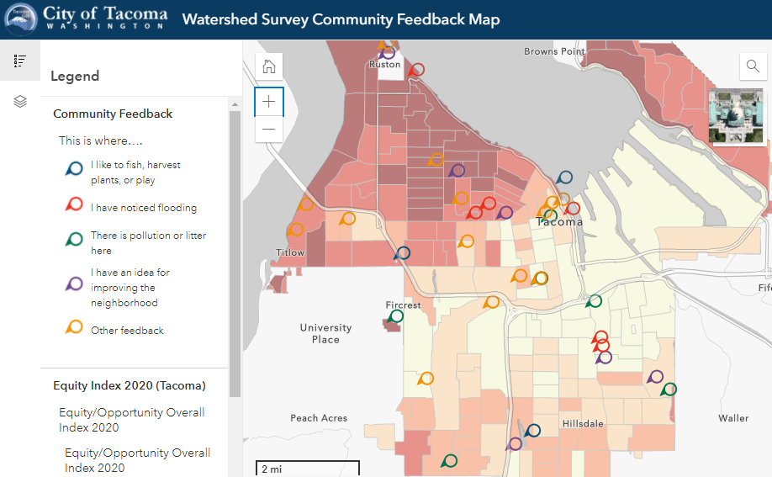
Stakeholder Engagement
Online Survey & Open House:
www.TacomaUrbanWatersheds.com
Two Virtual Community Workshops
  Saturday Sept. 25 1:00-2:30 pm
  Tuesday Sept. 28 5:00-6:30 pm
Neighborhood Council and Safe Streets Meetings
Watershed Council Meetings
Partner/Stakeholder Interviews
Cross-jurisdictional Coordination

Slide 15
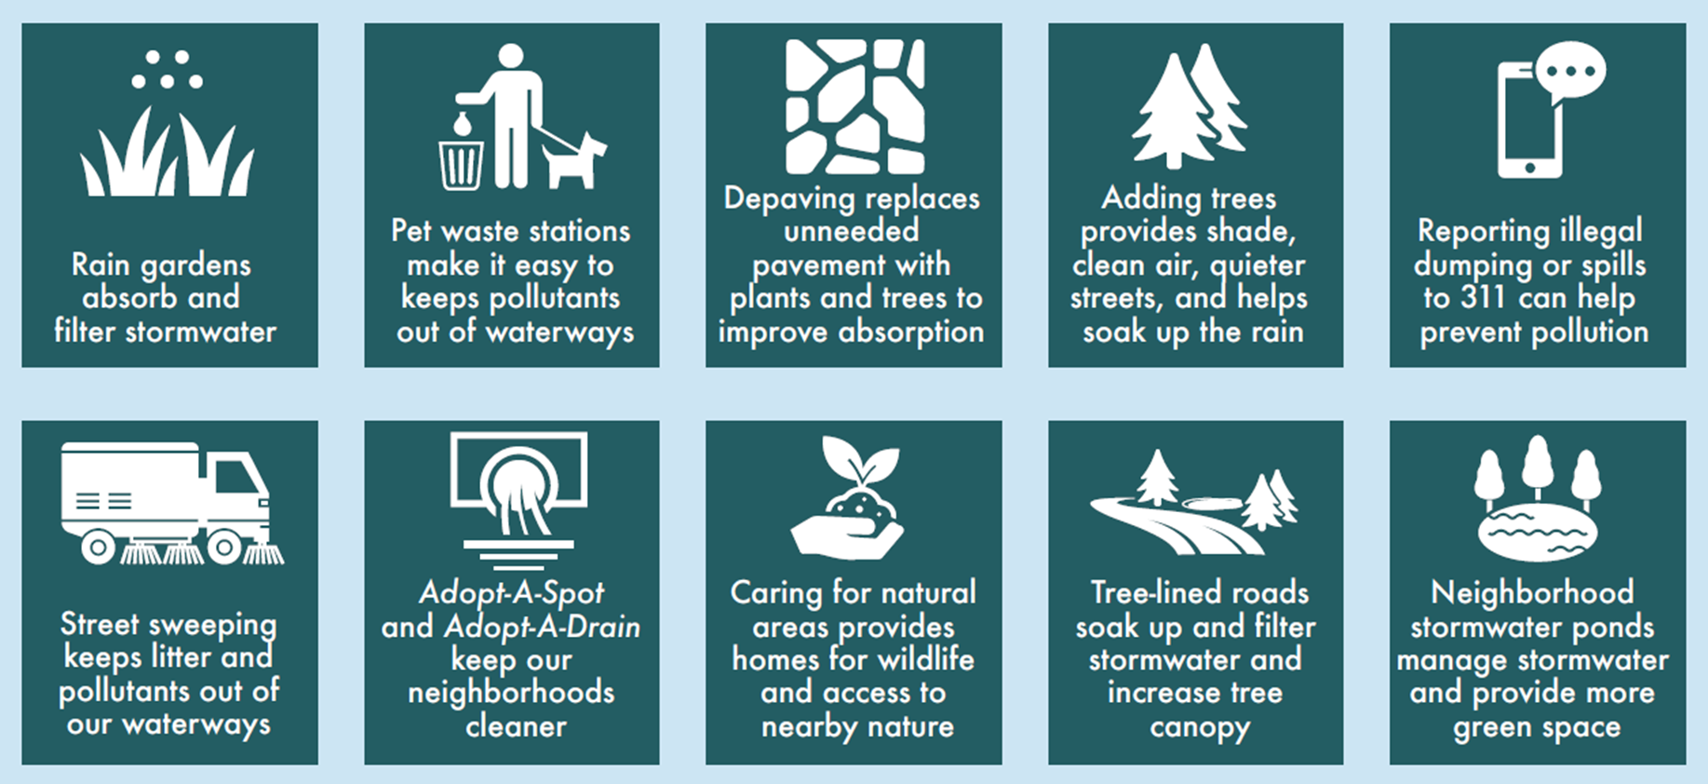
Healthy Watersheds make
Healthy Neighborhoods
Stormwater solutions for a cleaner and greener neighborhood

Slide 16
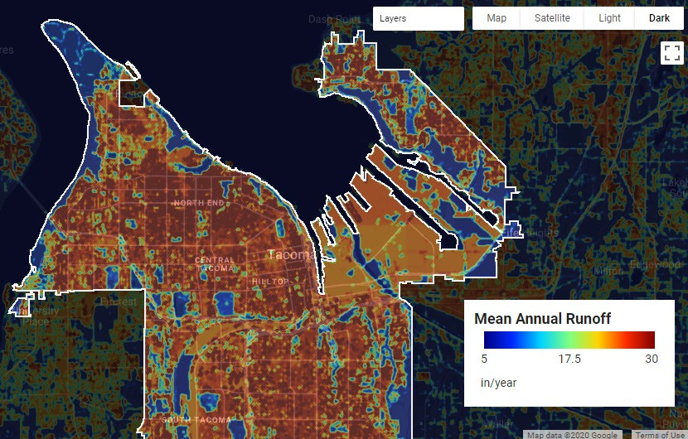
Watershed Prioritization Tool
Identify pollution hotspots
Best actions to reduce pollution
Identify desired community
co-benefits to help rank actions
Cost-benefit analysis
Ability to track stormwater actions and changes over time

Slide 17

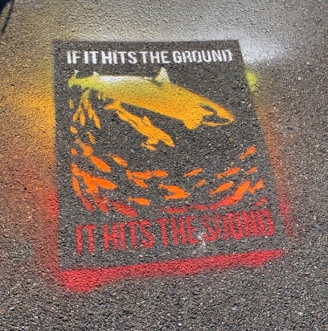
Opportunities for community
Adopt-a-drain program
  www.adopt-a-drain.org/wa
Storm drain stencil art and curb marking

Slide 18
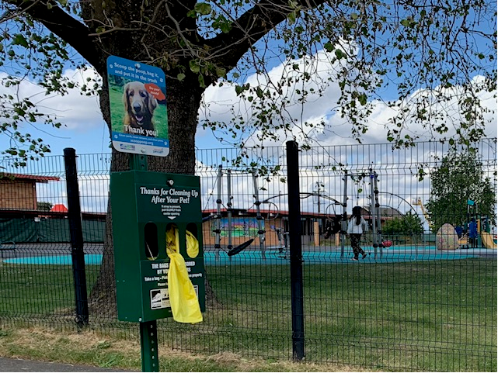


Opportunities for community
www.cityoftacoma.org/preventstormwaterpollution
Sponsor a neighborhood dog waste station
Make a Splash grants – up to $4,000 reimbursement
Call in spills or dumping at TacomaFirst311

Slide 19
Environmental Services Commission
City of Tacoma | Environmental Services Department
Next ESC Meeting:
November 18, 2021 @ 4 p.m.

